Slide 1
Performance Testing:
K6 vs. JMeter
Do Huynh Diem Uyen - 22125117
Pham Ngoc Phuong Uyen - 22125118
Trinh Nguyen Thao Vi - 22125120
Huynh Phan Nhat Vy- 22125124
Group 12

Slide 2
Today's Objectives
Understand what performance testing is and why it's essential.
Explain the different types of performance tests (Load vs. Stress).
Introduce & Compare two key tools: k6 and Apache JMeter.
Demonstrate how to run a basic test with a practical demo.
Emphasize its impact on user experience and system stability.

Slide 3
What is Performance Testing?
What is it?
A non-functional method to measure a system's speed, responsiveness, and stability under a specific workload.
This covers both unit/API testing and full system testing.
Primary Goals
Evaluate application output, processing speed, and response times.
Measure resource usage (CPU, memory, bandwidth).
Determine the maximum concurrent users and find bottlenecks.

Slide 4
Who Benefits from Performance Testing?
Technical Teams
Developers: Find performance issues early in the SDLC.
QA Teams: Validate application speed, stability, and scalability.
DevOps: Automate testing in CI/CD pipelines to prevent regressions.
Business & Management
Project Managers: Assess risks related to system changes and impact.
CTOs & Owners: Plan long-term growth and protect revenue streams.
Finance/Healthcare: Ensure compliance with industry regulations.

Slide 5
Why is Performance Testing Critical?
01
02
03
04
Enhances User Experience
Fast loads prevent abandonment. Shopify data shows bounce rates triple after 3 seconds.
Prevents Downtime
Avoids catastrophic crashes during peak periods (e.g., Black Friday sales), protecting revenue.
Supports Scalability
Ensures the application can grow with your user base and handle unexpected surges in traffic.
Reduces Costs
Fixing defects post-release costs 4-5x more than finding them during development (IBM).

Slide 6
Performance Testing Metrics
CPU utilization – percentage of CPU capacity utilized
Memory utilization – utilization of the primary memory
Response times – time between sending request and receiving response
Average load time – time to complete the loading process
Throughput – the number of transactions can be handled in a second
Average latency/Wait time – the time spent by a request in a queue before getting processed
Bandwidth – the volume of data transferred per second
Requests per second – the number of requests handled per second
Error rate – the percentage of requests resulting in errors
Transactions Passed/Failed – the percentage of passed/failed transactions

Slide 7
Load testing
Stress testing
Tests expected user load under normal conditions.
Volume testing
Finds the system's breaking point by overloading it.
Tests handling of large amounts of data.
Test Types
Tests sudden, intense surges in user traffic.
Tests performance over a long period (finds leaks).
Spike testing
Checks if the system can handle growth by adding resources.
Endurance Testing
Scalability testing

Slide 8
Load testing
What is it?
Simulates the expected number of users or transactions to assess the system’s behavior under normal conditions.
Example: An e-commerce platform must ensure smooth checkout even when hundreds of users shop during a Black Friday sale.
Why it matters?
Ensures critical functionalities (database queries, server responses) meet performance benchmarks during peak usage.

Slide 9
Stress testing
What is it?
Pushes the system beyond its normal operational limits to see how it behaves under extreme conditions.
Example: A ticket booking website for a significant concert must be stress-tested to see how it reacts to a surge in demand.
Why it matters?
Helps uncover weaknesses, such as system crashes or slow response times, before they occur in real-world scenarios.

Slide 10
Spike testing
What is it?
Evaluates how the system reacts to sudden surges in user traffic over a short period.
Example: An e-commerce site experiencing a traffic spike during a flash sale must remain functional.
Why it matters?
Ensures your application can recover quickly and continue to operate during abrupt demand increases.

Slide 11
Scalability testing
What is it?
Evaluates whether the system can handle increased traffic by adding resources (scaling up or out).
Example: A streaming platform must be scalable to handle millions of users when a popular show is released.
Why it matters?
Identifies the system’s capacity to expand through vertical scaling (more power) or horizontal scaling (more servers).

Slide 12
Endurance testing
What is it?
Checks the system’s performance over an extended period under a consistent load (also called Soak testing).
Example: A CRM tool running continuously for days may experience a slowdown over time, impacting reliability.
Why it matters?
Identifies issues like memory leaks or performance degradation with prolonged usage. Ensures long-term stability.

Slide 13
Volume testing
What is it?
Examines system behavior when handling a large volume of data (e.g., in the database).
Example: A financial application managing millions of daily transactions must perform without slowdowns.
Why it matters?
Essential for big data applications and systems managing intensive data operations.

Slide 14
Comparison of Key Performance Test Types
Criteria | Load Test | Stress Test | Spike Test
Purpose | Verify performance under expected load | Determine system limits and failure behavior | Check reaction to sudden, extreme load
Load Pattern | Gradual increase to expected traffic | Gradual increase beyond maximum capacity | Sudden and sharp increase in load
Focus | Stability under normal conditions | System breaking point and failure | Resilience and recovery from spikes
Example | Typical peak shopping time | Black Friday or concert ticket release | Flash sale announcement

Slide 15
The Performance Testing Process
1. Identify Environment
2. Define Criteria
3. Plan & Design
Set performance goals (e.g., "Homepage < 2s").
Create scenarios and define metrics.
Define the test setup.
4. Configure Environment
Prepare the test servers and tools.
5. Implement test design
6. Run tests
7. Analyze & Retest
Develop scripts and prepare test data
Execute and monitor
Find bottlenecks, fix, and test again.

Slide 16

Tool Overview:
k6
A Modern, High-Performance Tool
Designed for high performance (written in Go).
Excellent for API testing and microservices.
Integrates easily into CI/CD pipelines.
Use k6 when: You are comfortable with code, need high performance, or focus on API automation.

Slide 17
Modern, open-source tool (built in Go) for testing APIs and microservices. CLI-driven, using JavaScript for test scripts.
Advantages
Developer-friendly (tests are code).
Lightweight, fast, and low resource use.
Ideal for automation and CI/CD pipelines.
Disadvantages
No GUI (requires scripting knowledge).
Limited protocol support (mainly web/API).
Advanced features may require k6 Cloud.

Slide 18
K6 Configuration & Setup
Installation | Test Configuration | Output Config
Lightweight single binary (install via Installer, Brew, Choco) or run via Docker. No external dependencies (like Java). | Code-based: All configurations (VUs, Duration, Thresholds) are defined in the options object within the JavaScript file. Flexible: Can override configs via CLI flags (e.g., --vus 100 --duration 10s). | Easily streams metrics to external backends (Prometheus, InfluxDB, JSON) via simple command-line arguments (--out).

Slide 19
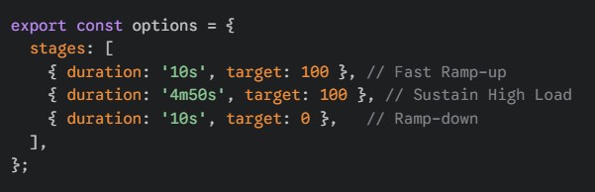
Scenario A: High Load Strategy (Stress Test)
Phases (Total Duration: 5m 10s):
1. Ramp-up (10s): Rapidly increase from 0 to 100 VUs to simulate a sudden influx of users.
2. Sustain (4m 50s): Maintain steady load at 100 VUs to monitor resource usage (CPU/RAM) and latency over time.
3. Ramp-down (10s): Decrease to 0 VUs to finish the test gracefully.
k6 Configuration:

Slide 20
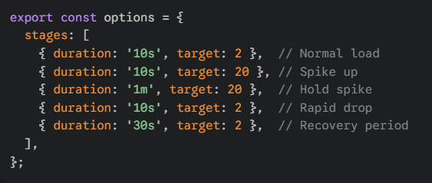
Scenario B: Spike & Recovery Strategy
Phases (Total Duration: ~2 mins):
Normal Load (10s): Run at 2 VUs (Baseline).
Spike (10s): Rapid jump to 20 VUs (10x load).
Hold Spike (1m): Stress system at peak capacity.
Recovery (10s): Drop load back to baseline (2 VUs).
Recovery Period (30s): Monitor if latency returns to normal levels.
k6 Configuration:

Slide 21

Tool Overview:
Apache JMeter
A Popular, Powerful GUI Tool
Written in Java, open-source, and has a large community.
Supports many protocols (Web, API, Database, FTP, etc.).
Powerful for testing complex, end-to-end user workflows.
Use Jmeter when: You prefer a visual builder, need to test complex workflows, or test non-web protocols.

Slide 22
Open-source, 100% Java application for load testing. Originally for web, now supports many protocols. Uses a GUI to build test plans.
Advantages
Rich GUI interface (easy for beginners).
Supports many protocols (HTTP, JDBC, FTP, etc.).
Extensive plugin ecosystem.
Disadvantages
High resource consumption (Java-based).
Reporting is basic without plugins.
Less "developer-friendly" for CI/CD.

Slide 23
Classify the advantages
Feature | k6 (by Grafana Labs) | Apache JMeter
Scripting | JavaScript (Code-centric) | GUI (Visual test plan)
Primary Use | APIs, Microservices, Web | Web, Complex Workflows, Various Protocols
Performance | Very High (Written in Go) | Good (Written in Java)
Ease of Use | Easy for devs, harder for non-coders | Easy for non-coders (GUI), can get complex
Ecosystem | Modern, CI/CD friendly | Mature, large community, many plugins

Slide 24
JMeter Configuration & Setup
Prerequisites | Resource Tuning | Execution Mode
Requires Java (JDK 8+) installed. No installation wizard; simply unzip the archive to run. | Critical: Must manually increase JVM Heap Size (in jmeter.bat or .sh) to handle high loads (e.g., -Xmx4g). Disable "View Results Tree" listeners during actual tests to save memory. | GUI Mode: Use only for test design and debugging. CLI (Non-GUI) Mode: Mandatory for actual load testing to ensure performance (jmeter -n -t test.jmx).

Slide 25
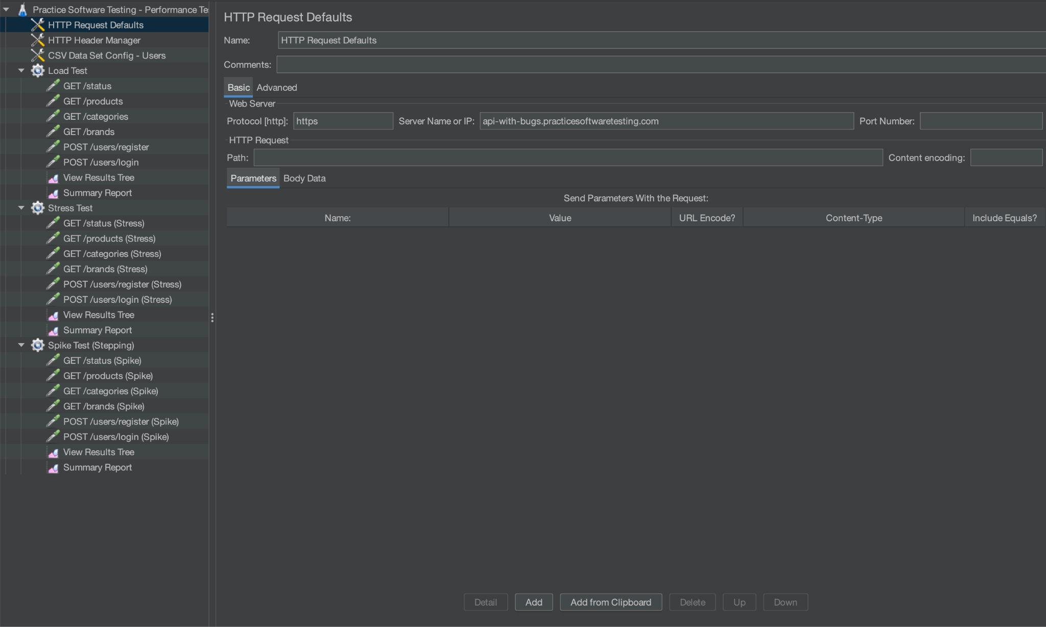
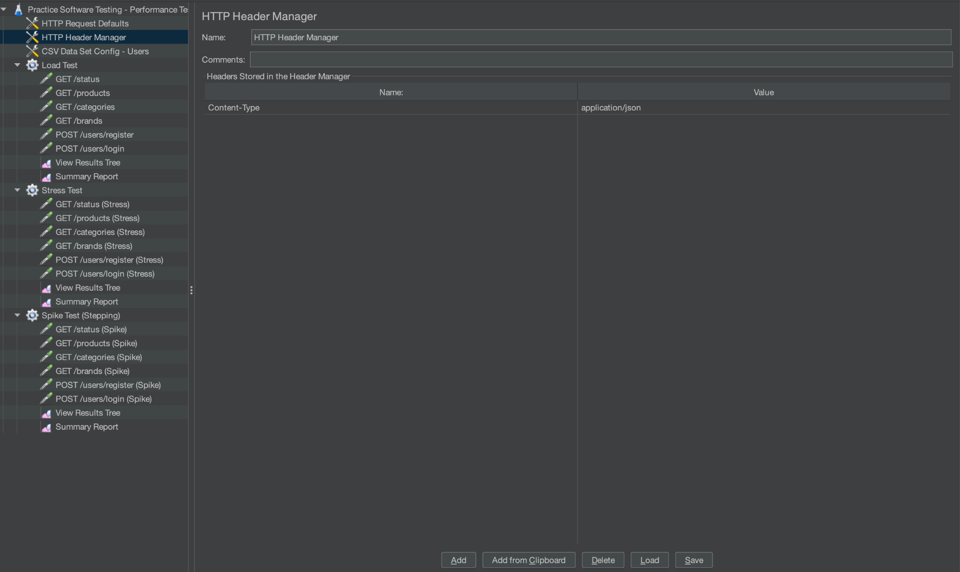
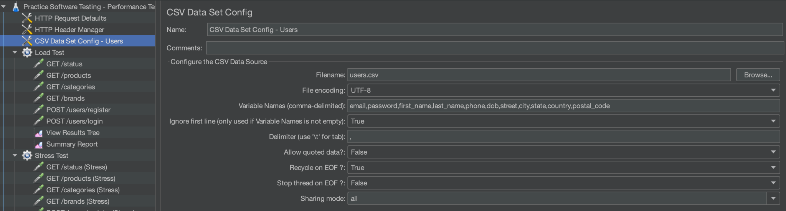
JMeter: Global Configuration
HTTP Request Defaults: Defines the Server Name (api-with-bugs...) and Protocol (https) centrally to avoid repetition.
HTTP Header Manager: Sets Content-Type: application/json for all requests to ensure correct API communication.
CSV Data Set Config: Loads external data (users.csv) to variables (email, password) for realistic user simulation.

Slide 26
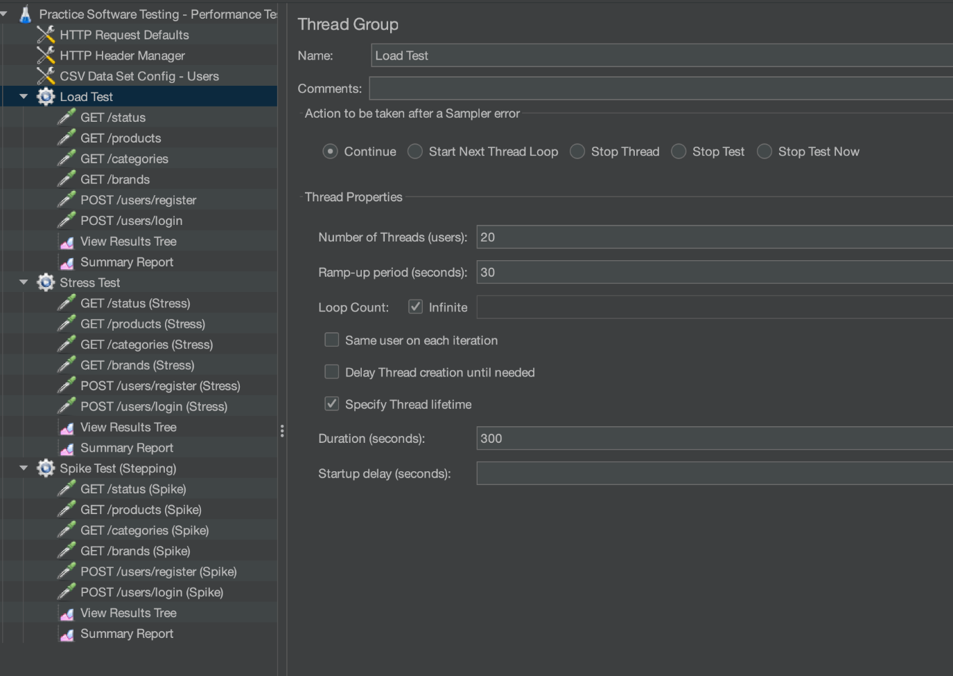
JMeter: Load Test Configuration
Threads (Users): 20 (Simulates normal expected traffic).
Ramp-up Period: 30s (Users join gradually, ~0.6 users/sec).
Duration: 300s (5 minutes stability check).

Slide 27
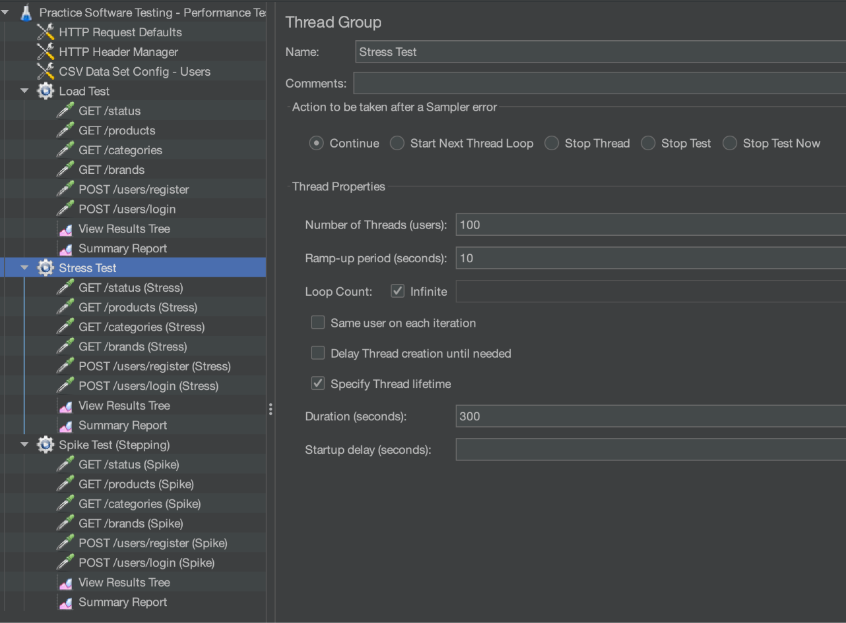
JMeter: Stress Test Configuration
Threads (Users): 100 (5x normal load).
Ramp-up Period: 10s (Aggressive loading, 10 users/sec).
Duration: 300s

Slide 28
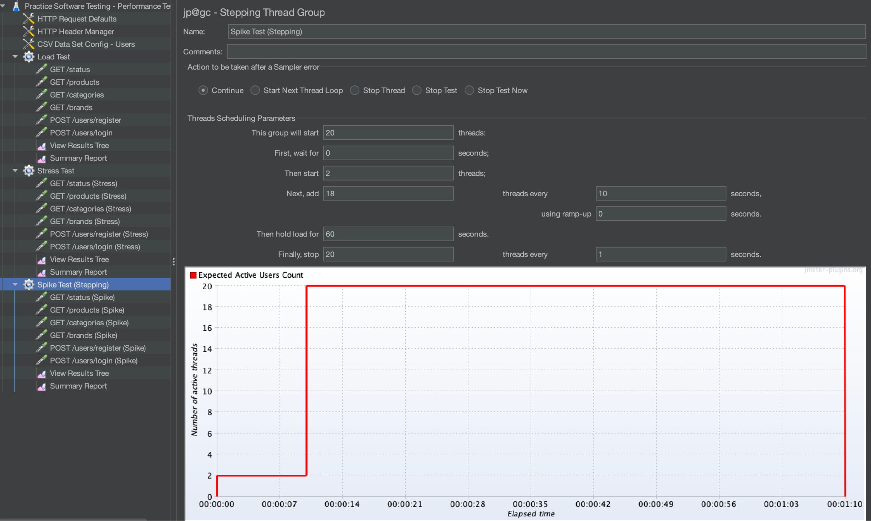
JMeter: Spike Test Configuration
Using "Stepping Thread Group" (Standard Set Plugin) for better control.
Start with baseline: 2 users.
Spike: Add 18 users instantly (0s ramp-up).
Hold: Sustain 20 users for 60s.
Drop: Stop users immediately.

Slide 29

Demo

Slide 30
Getting Started with JMeter
Prerequisites:
Java is required: Verify via command java -version
If you see "command not found" or "not recognized", please install the Java JDK first.
OS: Cross-platform (Windows, macOS, Linux).
Installation:
https://jmeter.apache.org/download_jmeter.cgi
Under Binaries, download the .zip file (e.g., apache-jmeter-5.6.3.zip).
Extract the .zip file to a location like C:\Tools\jmeter.
Go to the extracted folder, open the bin folder.
Double-click on jmeter.bat (The JMeter GUI will open.)
For Windows Users

Slide 31
Getting Started with JMeter
Prerequisites:
Java is required: Verify via command java -version
If you see "command not found" or "not recognized", please install the Java JDK first.
OS: Cross-platform (Windows, macOS, Linux).
Installation:
Option A: Via Homebrew (Recommended/Fastest)
Open Terminal and run: brew install jmeter
Launch by typing: jmeter
Option B: Manual Download
https://jmeter.apache.org/download_jmeter.cgi
Download the Binaries file ending in .tgz.
Double-click the .tgz file to unzip it.
Open Terminal and navigate to the bin folder inside the extracted JMeter folder: cd /path/to/apache-jmeter/bin
Run the startup script: sh jmeter.sh
For macOS Users

Slide 32
Do you have any question?

